Slide 1
Observatory Usage
A Project By the Software Architecture Group’s Master Project WS 22/23

Slide 2
General

Slide 3
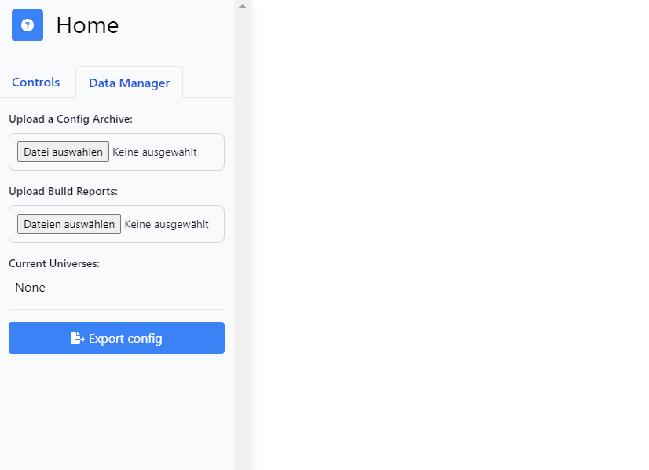
Import a previously exported configuration of the observatory the recreate your state
Upload a Reachability or Causality Export of GraalVM Native Images ( = Universes)
Export your current configurations, e.g. uploads, selectios, filters, … and share them with others

Slide 4
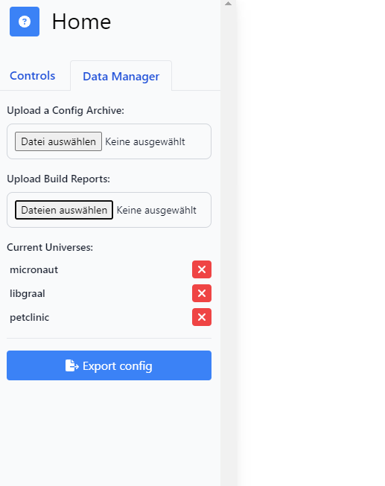
Your uploaded universes will appear here. Double click the text to rename them!

Slide 5
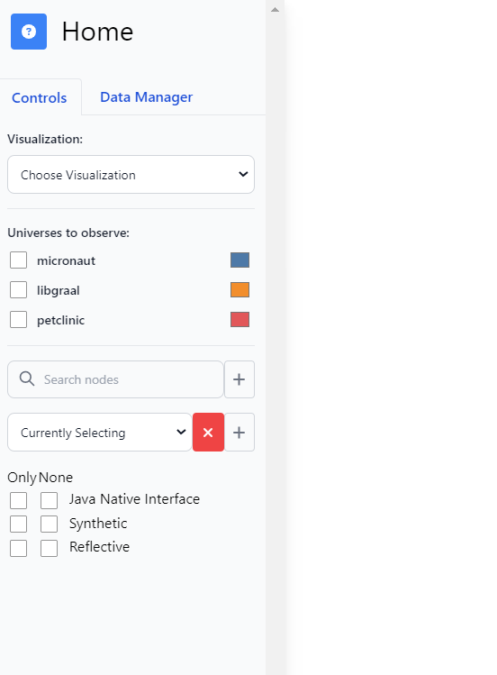
Set chosen universes visible in the visualization

Slide 6
Click “+” to add the current term as a filter
Type in names of Modules, Packages, etc., to highlight every item containing the search term

Slide 7
Click to display all of your selected items. Usually by pressing (ctr +) left click on an item. The “x” will clear the selection

Slide 8
Use the filters to display nodes only having a certain attribute. Or, all nodes not having this attribute.

Slide 9
Venn Sets

Slide 10
Foo
Foo ∩ Bar
On the module layer, the two universes “Foo” and “Bar” contain “java.base” each, thus it’s in the intersection.
With its size of 6.65 MB it belongs to one of the bigger modules, represented by the radius
jdk.internal.vm. compiler
jdk.net
Bar
jdk.crypto.ec
java.base
java. logging
Notes:
Welcome to the Venn Sets! In this visualization, you can find overlaps or disjunctions between multiple GraalVM Universes. Or, you can simply explore the contents of a single one.
As Java applications have different levels of details - packages, modules, or methods - use the control’s slider to set the level you want to focus on. The displayed intersections are up to the set level only. For example, two universes sharing the package “java.util.logging” may share different classes in that package. The first universe may exclusively have the contained class “LoggerContext”, the second generated ones like “Level$LevelContext”, and both of them sharing “LogManager”. Notice the bubble size too - they re-adjust with each level too. So a bubble with a radius of 3 on module level has a different code size than one on the method level. For absolute sizes, you want to check out the Tree Line!

Slide 11
Foo
Foo ∩ Bar
Using the slider to dive deeper, searching “java.base” highlights all packages in that module. It reveals that Foo doesn’t contain any packages of “java.base” which aren’t shared with Bar. Bar on the other hand has some exclusive packages like “java.base.javax.crypto”!
com .oracle .svm.core
java.util
Even though “org.graalvm.compiler.java” is bigger than “java.base” one layer above, it’s only 400KB. Its size is relative to the layer.
jdk.vm.ci.code
Bar
java.io
javax. crypto
java.net
org.graalvm.compiler.java

Slide 12
Tree Line

Slide 13
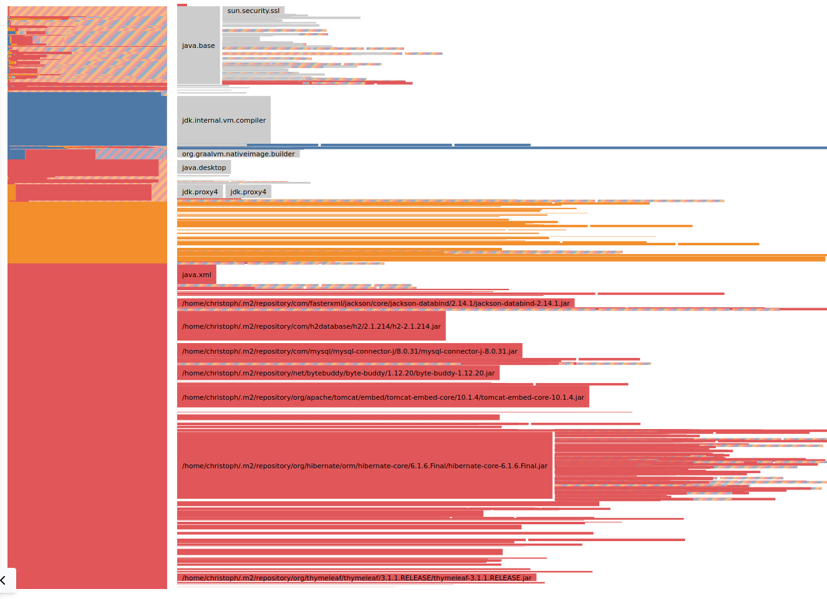
You can use the Tree Line to find out what images contain and which parts take up how much space. When diffing multiple images, each image has a color, which you can see in the configuration panel. The Tree Line below diffs three images (blue, orange, and red).
On the left, there’s a big colorful bar.
On the right, there’s a hierarchy.

Slide 14
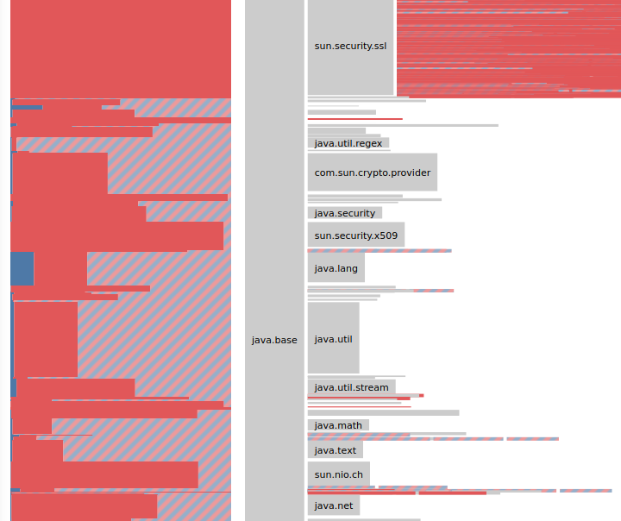
The hierarchy shows what’s in the union of all images, scaled vertically by the size of the code.
We can see that java.util takes up about three times as much space as java.lang.
Depending on how much visual space is available, the hierarchy shows everything from top-level JARs to individual methods.

Slide 15
For each leaf you see in the hierarchy, the bar on the left describes its composition over all images.
Only a tiny amount of the java.util code is used exclusively by the blue image.
The vast majority of java.util is used by both the red and the blue image.
The red image uses a bigger chunk exclusively.

Slide 16

You are intrigued by something you see? The main mode of interaction with the Tree Line is zooming. Hover over the package you want to focus on and zoom in.
scroll to zoom in

Slide 17
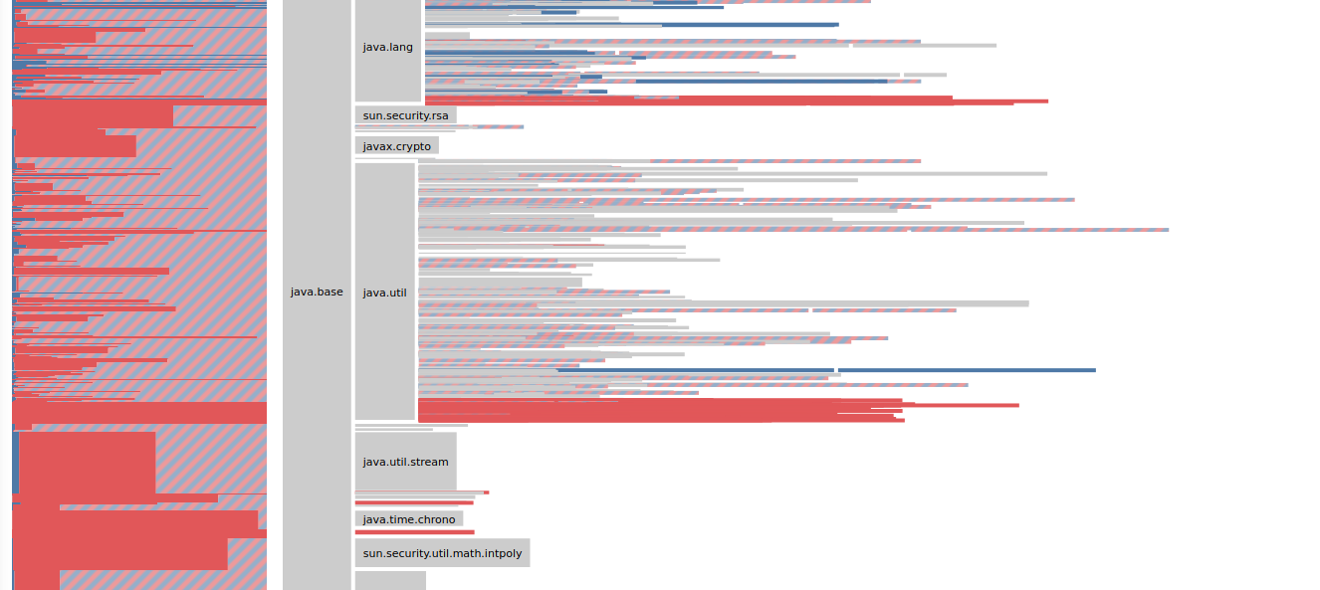
Boom! At some point, the node you focused on will “explode” and show its children. When that happens, the bar on the left also changes to show the composition of the children.

Slide 18
You can keep zooming in. For example, what’s this blue part?

Slide 19
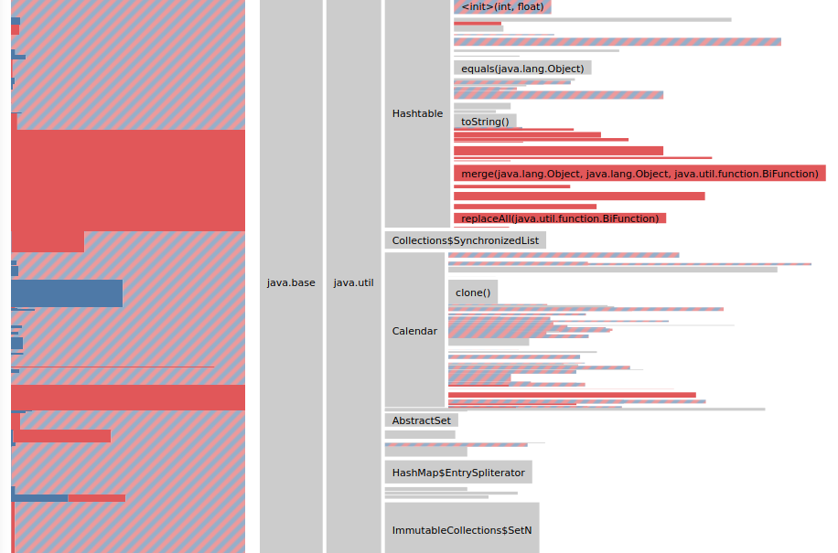
Well, looks like GraalVM Native Image is able to simplify the Calendar.clone() function in the red image further than in the blue one.
Name: ;java.base;java.util;Calendar;clone()
blue: 3.00 KB
red: 1.57 KB
Why is that happening? That’s a story for another time…

Slide 20
That makes it easy to spot code exclusively used in one image…
By the way: If the left bar only has one style, the node in the hierarchy is also colored in that style.
…or code that’s entirely shared among all images.

Slide 21
Also, the area on the left is always directly proportional to the amount of code.
For example, you can visually compare the size of these parts.

Slide 22
Sankey Tree

Slide 23
Layer Selection:
The default for the selected layer is “packages” due to performance reasons.

Slide 24
Layer Selection:
Changing the layer to a finer granularity allows for expanding the tree to a deeper level but sacrifices performance.
When rebuilding the sankey tree, a random branch is expanded to its deepest level to demonstrate the granularity change.

Slide 25
[NOTE] Filtering for a custom nodes selection:
Please, note that when filtering for a custom selection, branches where nodes other than the node at the end of a hierarchy level X is selected get filtered out and don’t appear on screen.
For example, only when node ci or code (=last node on the branch) from ;jdk.internal.vm.ci;jdk.vm.ci.code is selected, the branch containing this node is filtered in. Selecting any other node here (e.g., ;jdk), filters this branch out.
A node’s position in the hierarchy is indicated by its path, shown in the tooltip.

Slide 26
CutTool

Slide 27
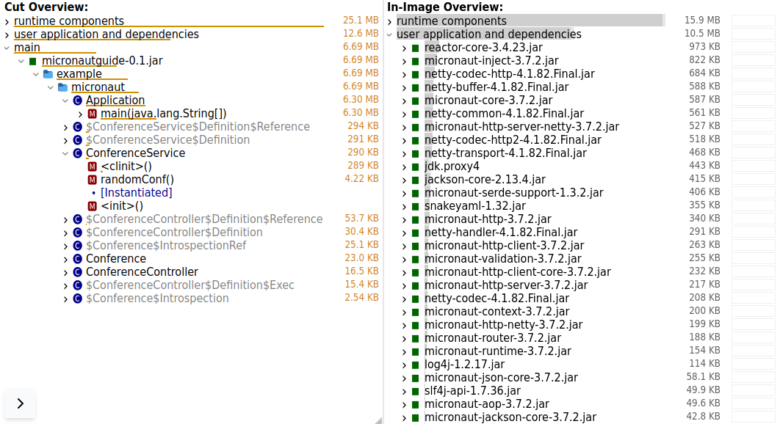
See what takes space in the image

Slide 28
Prediction of cutoff potential

Slide 29
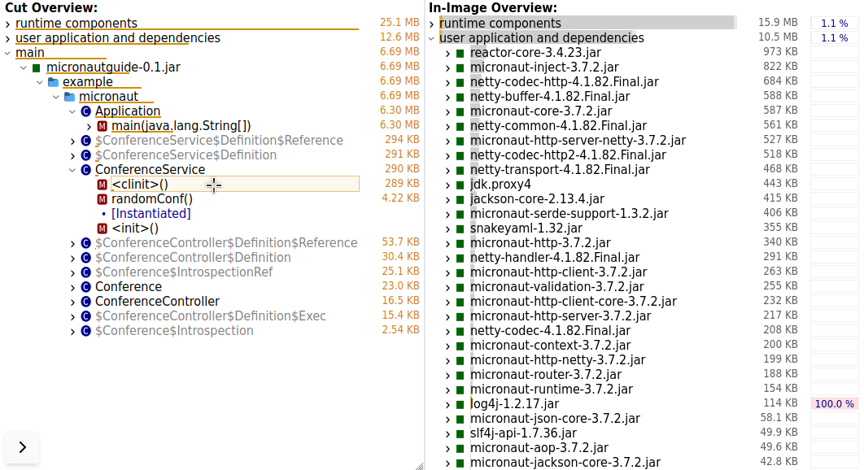
Preview cut result on hover

Slide 30
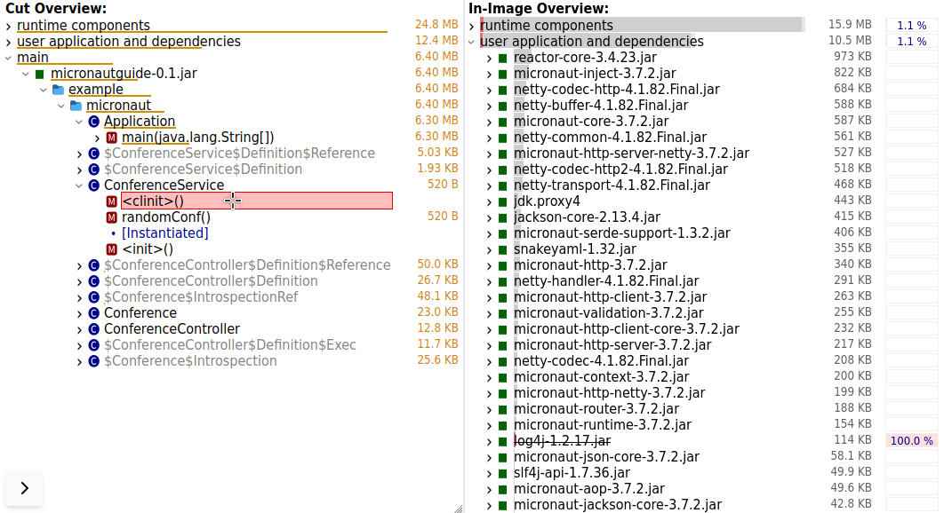
Explore further
Add to permanent cutting selection

Slide 31
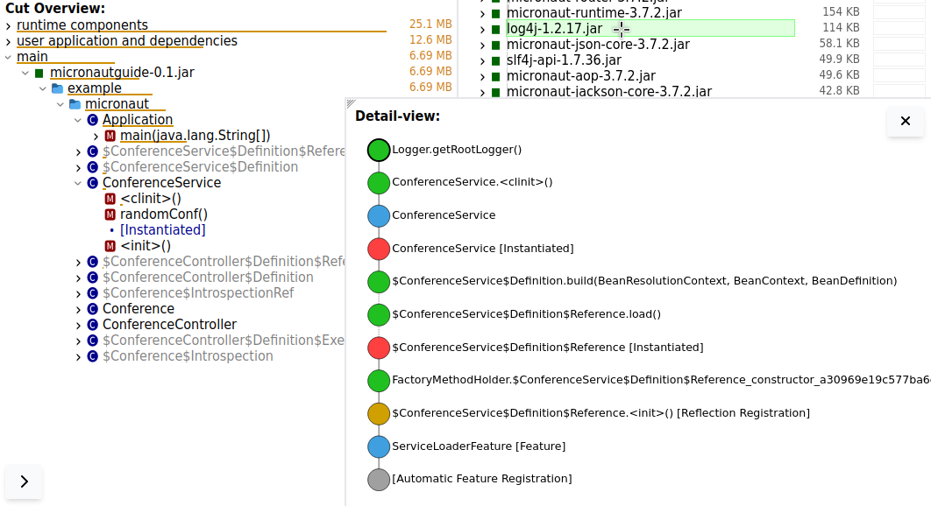
Select for details
Path making log4j reachable

